Slide 1
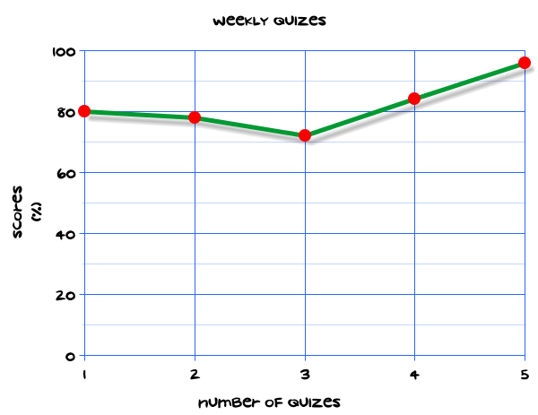
My Statistics Interactive Notebook
Name
Class
Teacher
Term 1 Semester 1
1

Slide 2
24
7
30
Date
Statistics
EQ – How do I read different statistical graphs?
Finish mean/median/mode/range worksheet or do Times tables if finished
How do we calculate the mean?
How do we find the median?
How do we find the mode?
What is the range?
5

Slide 3
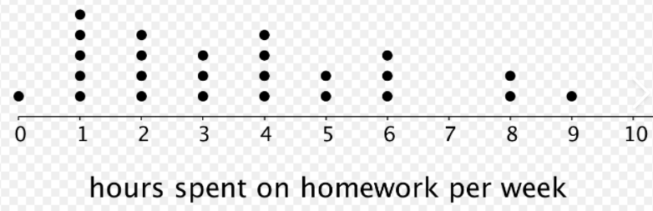
24
7
30
Date
Statistics
EQ – How do I read different statistical graphs?
What do I need to know about dot plots?
It represents only one set of data
Each dot represents a value on the number line
If value occurs more than once, it goes on top of other dot
Number of dots = frequency
Examples: 5 people spent 1 hour on homework, 2 people spent 8 hours on homework
How do we calculate the total number of people surveyed?
5

Slide 4
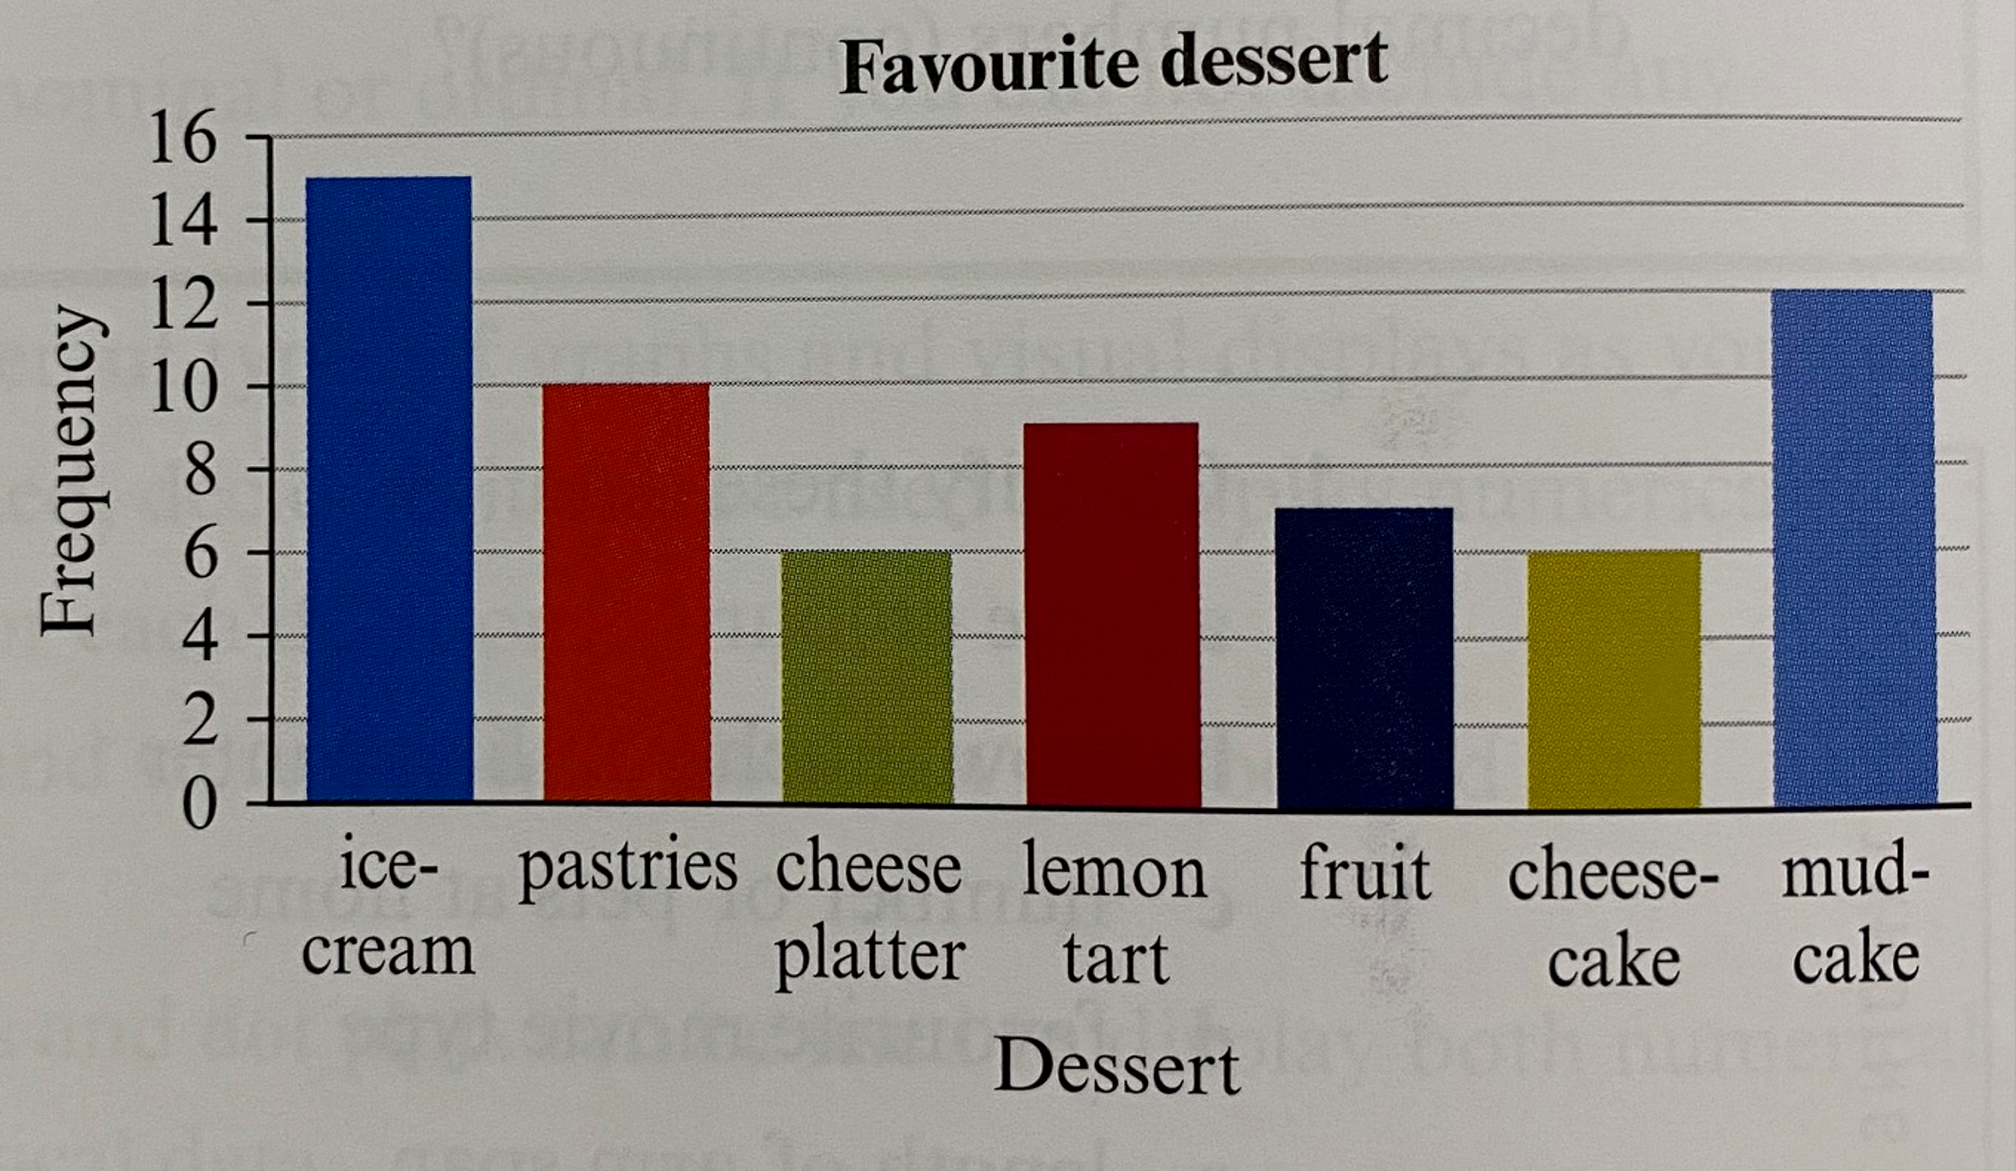
24
7
30
Date
Statistics
EQ – How do I read different statistical graphs?
What do I need to know about column graphs?
It has frequency up the left side – which can also be called number of people/quantity or other similar
We can compare the relative size of different categories (bottom)
Examples from chart: 15 people like icecream best, 6 people cheese platter, 12 people mud cake
How do we find the total number of people surveyed?
Can you see the similarities to a dot plot?
5

Slide 5
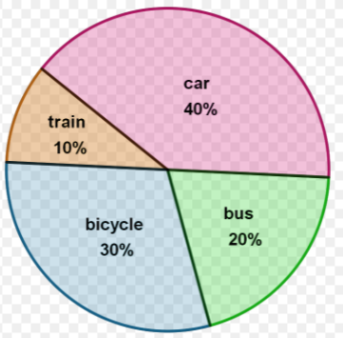
24
7
30
Date
Statistics
EQ – How do I read different statistical graphs?
What do I need to know about pie charts?
Each piece represents a category
It will usually have a % or a quantity on each piece
The whole circle should add up to 100%
If 100 people were surveyed on transport to school, how many students rode a bike?
If 3000 students were surveyed, how many rode in a car?
5

Slide 6
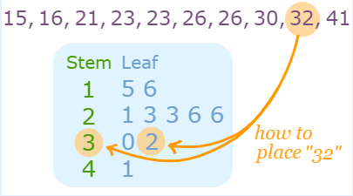
24
7
30
Date
Statistics
EQ – How do I read different statistical graphs?
What do I need to know about stem and leaf plots?
The leaf represents the last digit in the numbers
The smallest number goes closest to the stem
The stem represents the first digit/digits
5

Slide 7

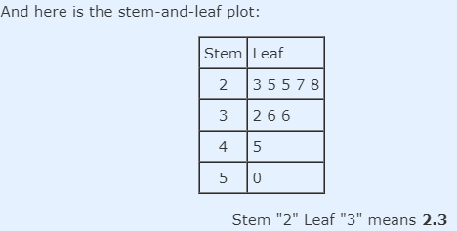
24
7
30
Date
Statistics
EQ – How do I read different statistical graphs?
What do I need to know about stem and leaf plots?
Do a stem and leaf for this data
5

Slide 8
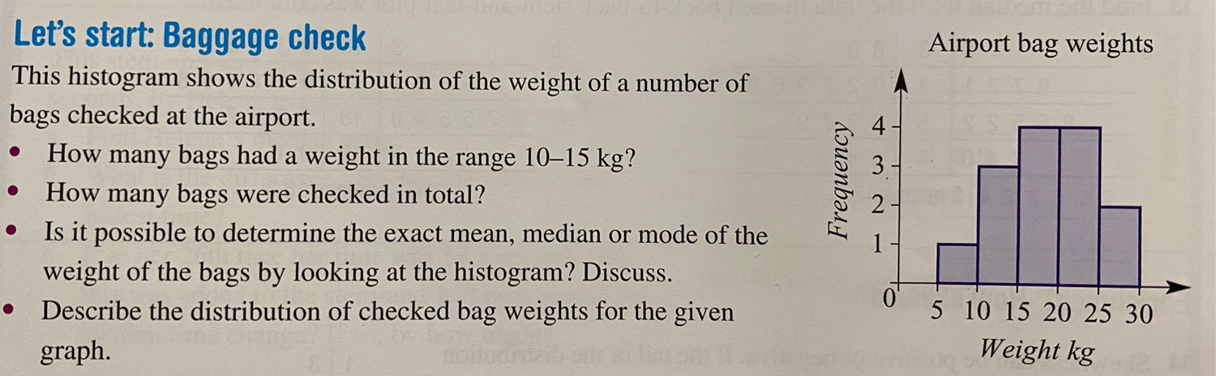
24
7
30
Date
Statistics
EQ – How do I read different statistical graphs?
What do I need to know about histograms?
Can you see the difference between a histogram and a column graph?
A histogram represents grouped numerical data
Height of each column corresponds to a frequency/quantity
5

Slide 9
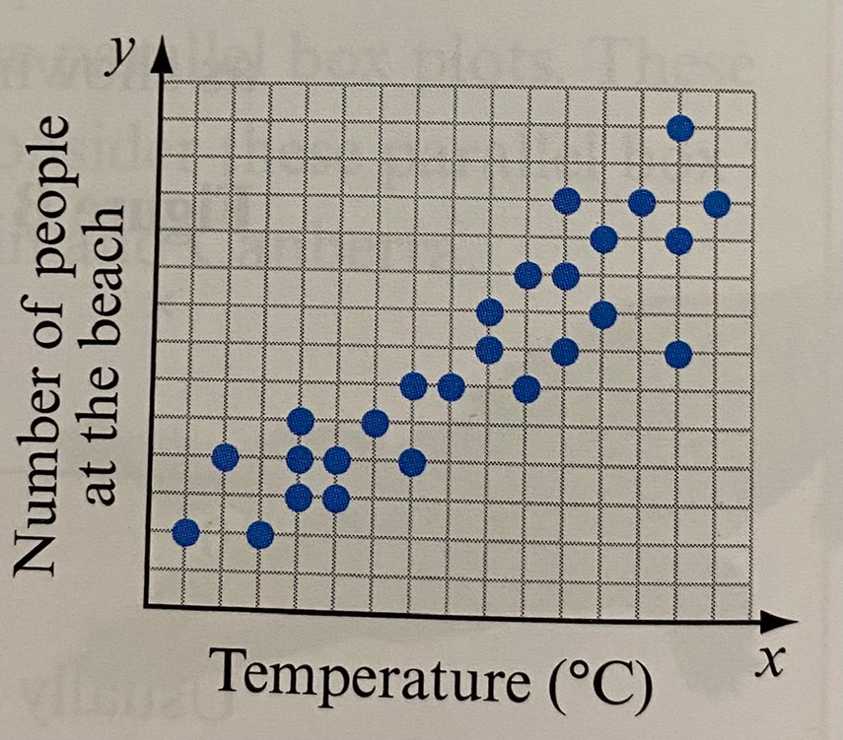
24
7
30
Date
Statistics
EQ – How do I read different statistical graphs?
What do I need to know about scatter plots?
Scatterplot allows us to see if there is a relationship between two variables and can be used to predict
5

Slide 10
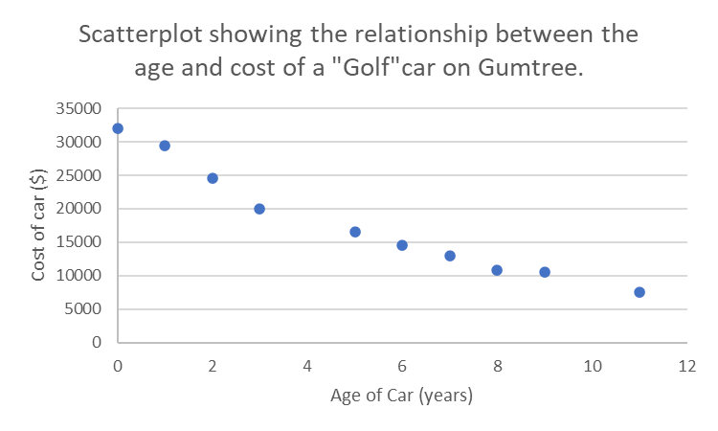
24
7
30
Date
Statistics
EQ – How do I read different statistical graphs?
What do I need to know about scatter plots?
How much would it cost to buy a 7 year old golf cart?
How much would it cost to buy a 1 year old golf cart?
If I had $15000, what is the lowest age golf car I could buy?
5

